Slide 1
Pre-Operative Clinical Trials
In Drug Development
Tricia Cottrell MD, PhD
Wendy Parulekar MD, FRCP(C)

Slide 2
Workshop Objectives
To identify role(s) of pre-operative trials in cancer drug development
Identify key trial elements that guide the design of pre-operative trials
Design a pre-operative platform trial testing novel agents in patients with resectable NSCLC

Slide 3
Clinical Trials in the Perioperative Setting
Preoperative
    Neoadjuvant: Therapeutic intent trials that test novel treatment; use an intermediate endpoint measured at surgery
      e.g. pathologic complete response measured to surgery
    Window of Opportunity: Non therapeutic trials that test novel therapies; use a feasibility or biomarker endpoint measured at surgery
      Ki-67 status
  Post operative clinical trials
    Adjuvant: Therapeutic intent trials that test novel treatment strategies; use surgical findings to assign treatments (e.g. presence of residual disease); clinically validated endpoints e.g. event free survival

Slide 4
Drug Development In Oncology
Paradigm of drug development in the era of cytoxic chemotherapy
  Direct relationship between toxicity and anti-tumour effect
  Normal tissue dose limiting toxicity used to select active dose for further testing
Paradigm of drug development in the era of targeted therapy
  May not have direct relationship between toxicity and target inhibition
  Plateau in target inhibition may occur at lower level than the MTD
  Greater emphasis on understanding the drug target

Slide 5
Drug Development In Oncology
Oncology drug development
  Expensive
  Time consuming
  Inefficient – high failure rate from drug discovery to regulatory approval
The pre-operative setting provides a unique opportunity to accelerate drug and biomarker development by enabling a comprehensive assessment of the pharmacodynamic effects of a novel therapy

Slide 6
Pre-Operative Clinical Trials in Drug Development
Pros
    Optimizes the intersection of research and practice workflows
    In vivo assessment of drug activity
    Biomarker discovery/validation
    Surrogate endpoint identification/validation
    Operative findings to guide adjuvant therapy decisions

Slide 7
Pre-Operative Clinical Trials in Drug Development
Cons
  Enhanced multidisciplinary collaboration
    Surgery, oncology, pathology, radiology
  Complex consenting procedure
    non therapeutic intent pre-operative trials
  Safety considerations
    e.g. delays in surgery or surgical complication
  Next steps
    How do the results impact continued drug development?

Slide 8
General Classification of Pre-Operative Clinical Trials
Therapeutic
Non-Therapeutic
Neoadjuvant
    Administration of multiple cycles of therapy
    Novel therapy + standard of care
    Intermediate endpoint – e.g. pCR
Window of Opportunity
    Limited administration of a novel therapy
    Single agent or combination with standard of care
    Feasibility and/or molecular endpoint e.g. % compliant; change in biomarker(s)

Slide 9
Key Design Elements
Objective(s)
    Estimate drug activity; feasibility; tolerability and safety
Patient Population
    All comers versus molecularly defined
Endpoint(s)
    Measure of anticancer activity; change in molecular target; compliance….
    e.g. pCR; change in biomarker; percentage compliant
Statistical Framework
    H0, HA, α (Type 1 error), β (Type II error); comparative measures e.g. hazard ratio (hazard ratio)

Slide 10
EXAMPLE 1

Slide 11
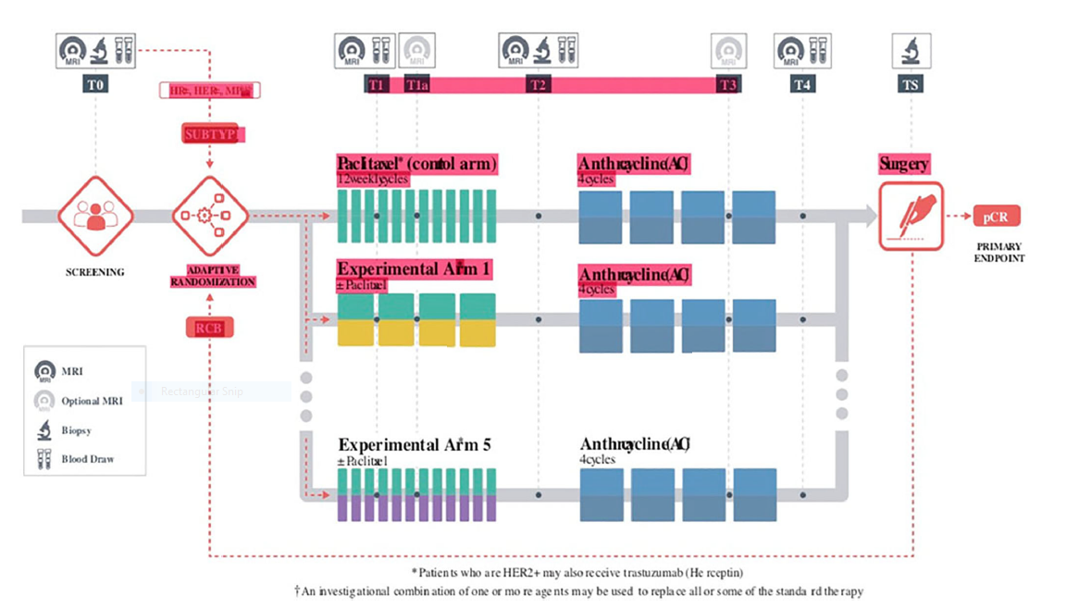
I-SPY 2: Neoadjuvant and Personalized Adaptive Novel Agents to Treat Breast Cancer (I-SPY) (NCT01042379)

Slide 12
I-SPY 2: Neoadjuvant and Personalized Adaptive Novel Agents to Treat Breast Cancer (I-SPY)
Primary Objective:
Determine whether adding experimental agents to standard neoadjuvant medications increases the probability of pathologic complete response (pCR) over standard neoadjuvant chemotherapy for each biomarker signature established at trial entry
Secondary Objectives:
Predictive and prognostic indices based on qualification and exploratory markers to predict pCR and residual cancer burden (RCB).
Three- and five-year relapse-free survival (RFS) and OS among the treatment arms.
Adverse events (AEs), serious adverse events (SAEs), and laboratory abnormalities
MRI Volume

Slide 13
I-SPY 2: Neoadjuvant and Personalized Adaptive Novel Agents to Treat Breast Cancer (I-SPY)
Multiple treatment regimens, matched to biomarker signatures graduated to move to phase III trials based on safety and efficacy including
    Neratinib
    Veliparib + carboplatin
    MK2206
    TDM1 + pertuzumab
    Pertuzumab (+ paclitaxel + trastuzumab)
    Pembrolizumab (+ paclitaxel + adriamycin + cyclophosphamide)

Slide 14
General Classification of Pre-Operative Clinical Trials
Therapeutic
Non-Therapeutic
Neoadjuvant
    Administration of multiple cycles of therapy
    Novel therapy + standard of care
    Intermediate endpoint – e.g. pCR
Window of Opportunity
    Limited administration of a novel therapy
    Single agent or combination with standard of care
    Feasibility and/or molecular endpoint e.g. % compliant; change in biomarker

Slide 15
EXAMPLE 2

Slide 16
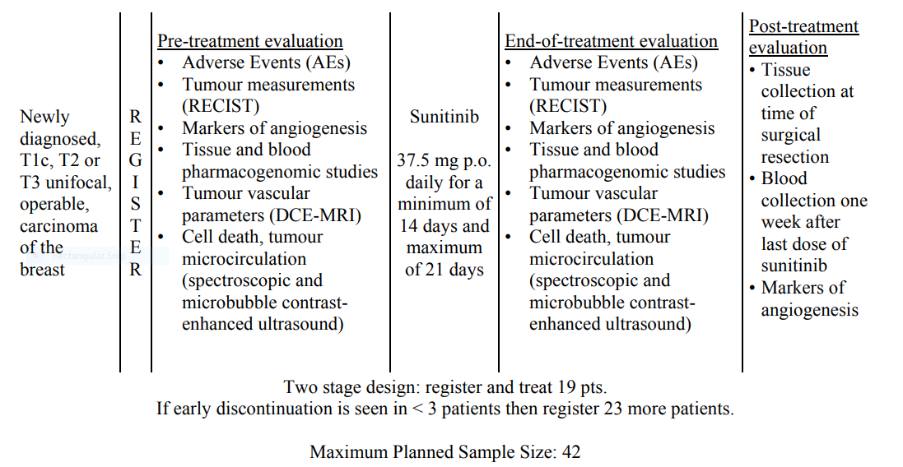
A FEASIBILITY STUDY OF PRE-OPERATIVE SUNITINIB (SU11248) WITH MULTIPLE PHARMACODYNAMIC ENDPOINTS IN PATIENTS WITH T1c-T3 OPERABLE CARCINOMA OF THE BREAST (MA.29) (NCT00482755)

Slide 17
A FEASIBILITY STUDY OF PRE-OPERATIVE SUNITINIB (SU11248) WITH MULTIPLE PHARMACODYNAMIC ENDPOINTS IN PATIENTS WITH T1c-T3 OPERABLE CARCINOMA OF THE BREAST (MA.29)
Primary Objective:
    Feasibility of pre-operative administration of this dose of daily, oral sunitinib.
Secondary Objectives:
    Adverse events
    Response rate
    Markers of angiogenesis at pre-treatment, end-of-treatment and post-treatment
    Host and tumour-specific genes in response and toxicity to sunitinib
    Banking of tumour and blood samples, at pre- treatment, end-of-treatment and post-treatment for future molecular correlative studies
    Comparison of tumour vascular parameters pre- and end-of-treatment; cell death and tumour microcirculation pre- and post-treatment.

Slide 18
A FEASIBILITY STUDY OF PRE-OPERATIVE SUNITINIB (SU11248) WITH MULTIPLE PHARMACODYNAMIC ENDPOINTS IN PATIENTS WITH T1c-T3 OPERABLE CARCINOMA OF THE BREAST (MA.29)
Early drug discontinuation rates
    H0= 20% Ha=5%
    Two stage design
      19 patients would be entered in the first stage, terminate trial if >3 or more patients discontinue sunitinib prematurely for any reason.
      In the second stage, 23 more patients would be accrued to a total of 42 patients. The regimen under evaluation would be considered feasible if there are 4 or fewer patients overall who discontinue the drug prematurely.
Trial activated 2007 March 12
Closed 2010 March 22 due to external phase III data in advanced breast cancer demonstrating lack of efficacy and increase toxicity of sunitinib in combination with chemotherapy; futility compared to single agent capecitabine

Slide 19
General Classification of Pre-Operative Clinical Trials
Therapeutic
Non-Therapeutic
Neoadjuvant
    Administration of multiple cycles of therapy
    Novel therapy + standard of care
    Intermediate endpoint – e.g. pCR
Window of Opportunity
    Limited administration of a novel therapy
    Single agent or combination with standard of care
    Feasibility and/or molecular endpoint e.g. % compliant; change in biomarker

Slide 20
Breakout Session

